Slide 2
“E-Inclusion: Creating a Barrier-Free Online Learning Environment for Primary School Students with Special Educational Needs in Hong Kong”
「數碼共融: 為有特殊教育需要的香港小學生營造無障礙的網上學習環境」研究
Professor Shelley Xiuli Tong / 佟秀麗教授
Faculty of Education / 教育學院
The University of Hong Kong / 香港大學
https://slrlab.edu.hku.hk

Slide 3
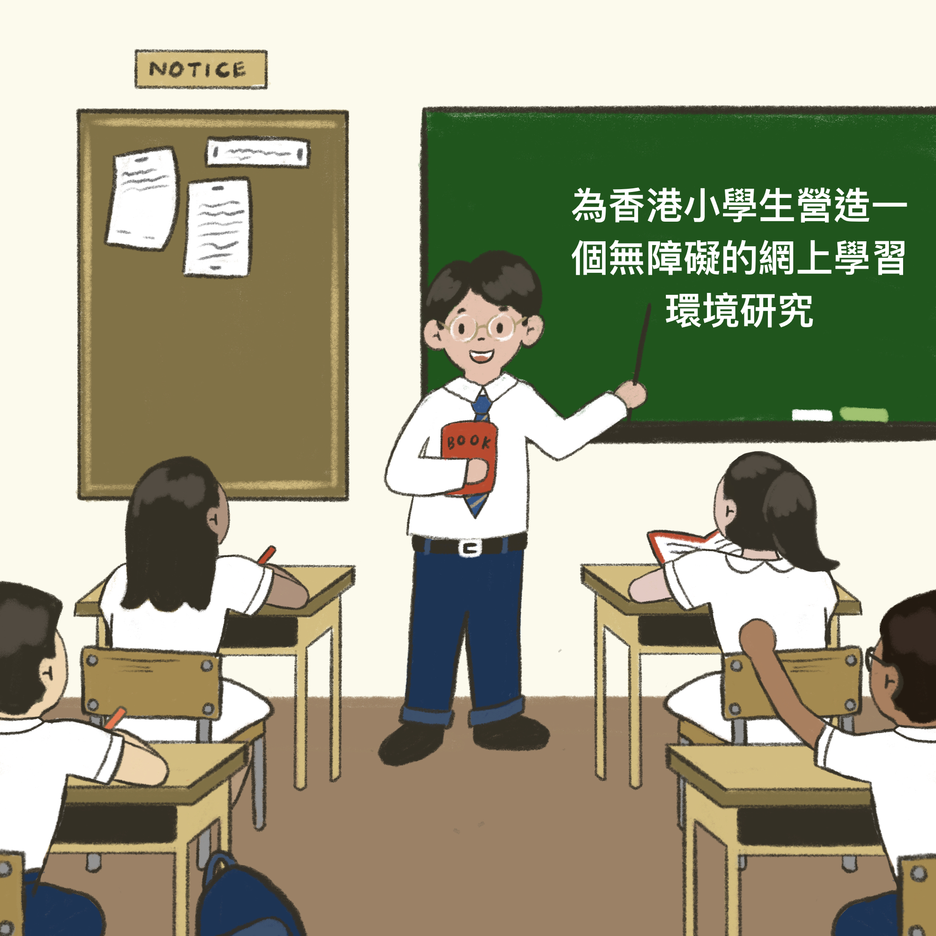
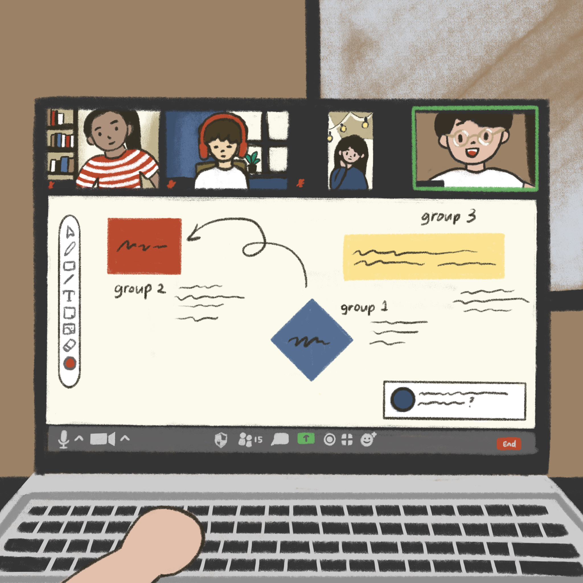
LEARNING Transformation / 學習形式轉變
+
Before Pandemic 疫情前
During Pandemic 疫情期間
Post Pandemic 疫情後

Slide 4
Emerging Issues / 新出現議題
During the pandemic 在疫情期間
Under the complete online learning environment 在完全網上學習的情況下
What are the specific challenges experienced by Hong Kong primary school students with different special educational needs (SEN)?
有不同特殊教育需要的香港小學生正面對甚麼具體的挑戰呢？
How do parents and teachers cope with children with SEN during online learning?
在網上學習期間，家長和老師如何應對有特殊教育需要的兒童呢？
No systematic tools for evaluating online learning effectiveness and attitudes
過往沒有任何系統性工具可評估網上學習的成效和態度

Slide 5
Research Aims / 研究目的
1
To examine the challenges and difficulties faced by children with SEN* and their parents and teachers
探討有特殊教育需要的學生，其家長及老師面對的挑戰和困難
2
To develop systematic tools that evaluate online learning effectiveness (attitude and process)
開發系統化工具以評估網上學習的成效 (態度和過程)
* SEN subtypes include Attention Deficit/Hyperactivity Disorder (ADHD), Autism Spectrum Disorder (ASD), Specific Learning Difficulties (SpLD), and Speech and Language Impairments (SLI)
* 有特殊教育需要的種類包括專注力不足/過度活躍症 (ADHD), 自閉症譜系障礙 (ASD), 特殊學習困難 (SpLD) 和言語障礙 (SLI)

Slide 6
A Bi-Stage, Integrated Approach 兩段式量質性整合研究
Stage 1
第一階段
(12/2020-03/2021)
A Quantitative Online Survey
量性問卷調查
Stage 2
第二階段
(07/2021-08/2021)
Qualitative In-Depth Semi-structured Interviews
質性半結構深入訪談

Slide 7
Online Survey Participants / 網上調查參與者
Notes:
Version 2

Slide 8
Online Survey: Developing Two Systematic Tools 網上調查: 開發兩套系統化工具
1. Online Learning Attitude Questionnaire (OLAQ)
網上學習態度問卷
Enjoyment
享受
Anxiety
焦慮
Utilization
應用
Development 發展
Motivation
動機

Slide 9
Key Result 1: Online Learning Attitude 結果一: 網上學習態度
Students with SEN exhibited lower learning attitudes than TD students
相對於一般發展學生，有特殊教育需要的學生的學習態度較低
Component 範疇 | Students’ Self-Rating 學生自評 | Caregivers’ Rating 家長評價 | Teachers’ Rating 老師評價
Enjoyment / 享受 | SEN = TD | SEN < TD | SEN < TD
Anxiety / 焦慮 | SEN > TD | SEN > TD | SEN > TD
Utilization / 應用 | SEN = TD | SEN < TD | SEN < TD
Development / 發展 | SEN = TD | SEN = TD | SEN < TD
Motivation / 動機 | SEN = TD | SEN < TD | SEN < TD

Slide 10
2. Online Learning Process Questionnaire (OLPQ)
網上學習過程問卷
Preparatory Phase
準備階段
Performance Phase
學習階段
Transfer Phase
應用階段
Learning Goals 學習目標
Prerequisites 已有知識
Environmental Structuring 家居學習環境
Learning Environment 網上學習環境
Time Management 時間管理
Engagement in Learning Activities 學習投入度
Persistence 堅持
Interaction between Teachers and Students 師生交流
Interaction among Students 朋輩交流
Feedback from the Interface 界面反饋
Maintenance of Skills and Knowledge 知識鞏固
Application of Skills and Knowledge 知識應用
Meaning of Learning 學習意義

Slide 11
Key Result 2: Online Learning Process / 結果二: 網上學習過程
 |  | Students’ Self-Rating 學生自評 | Caregivers’ Rating 家長評價 | Teachers’ Rating 老師評價
Preparatory Phase 準備階段 | Learning Goals / 學習目標 | SEN < TD | SEN = TD | SEN < TD
 | Prerequisites / 已有知識 | SEN < TD | SEN = TD | SEN < TD
 | Environmental Structuring / 家居學習環境 | SEN = TD | SEN = TD | SEN < TD
 | Learning Environment / 網上學習環境 | SEN < TD | SEN < TD | SEN < TD
Performance Phase 學習階段 | Time Management / 時間管理 | SEN < TD | SEN < TD | SEN < TD
 | Engagement in Learning Activities / 學習投入度 | SEN < TD | SEN < TD | SEN < TD
 | Persistence / 堅持 | SEN < TD | SEN < TD | SEN < TD
 | Interaction between Teachers and Students / 師生交流 | SEN < TD | SEN < TD | SEN < TD
 | Interaction among Students / 朋輩交流 | SEN < TD | SEN < TD | SEN < TD
 | Feedback from the Interface / 界面反饋 | SEN < TD | SEN < TD | SEN < TD
Transfer Phase 應用階段 | Maintenance of Skills and Knowledge / 知識鞏固 | SEN < TD | SEN < TD | SEN < TD
 | Application of Knowledge / 知識應用 | SEN = TD | SEN < TD | SEN < TD
 | Meaning of Learning / 學習意義 | SEN = TD | SEN < TD | SEN < TD

Slide 12
Key Result 3: Online Learning Attitude and Process across Different SEN Subtypes 結果三: 有不同特殊教育需要學生的網上學習態度及過程
Students’ self-rating and Caregivers’ rating 學生自評和家長評價
Teachers’ rating
老師評價
Students across different SEN subtypes had similar ratings in online learning attitudes and online learning process
有不同特殊教育需要的學生在網上學習態度和網上學習過程評價相若
Relative to other types of SEN students, 相對其他有特殊教育需要的學生,
ASD students had more anxiety and lower rating on time management 有自閉症譜系障礙的學生較焦慮和在時間管理方面較差
ADHD students had lower ratings on time management and engagement in learning activities 有專注力不足/過度活躍症的學生在時間管理方面較差和學習投入度較低

Slide 13
A Bi-Stage, Integrated Approach / 兩段式量質性整合研究
Stage 1
第一階段
(12/2020-03/2021)
A Quantitative Online Survey
量性問卷調查
Stage 2
第二階段
(07/2021-08/2021)
Qualitative In-Depth Semi-structured Interviews
質性半結構深入訪談

Slide 14
Qualitative In-Depth Semi-structured Interviews 質性半結構深入訪談
Interests
興趣
Different SEN Subtypes
不同特殊
教育需要
Personal Difficulties
個人困難
Semi-structured Interview
半結構式訪談
Learning Progress
學習進度
Environmental Difficulties
環境困難

Slide 15
Interview Result 1: Online Learning Facilitators and Difficulties
訪談結果一: 網上學習的有利因素和困難
Facilitators / 有利因素
Showed digital technological ability 擅長使用科技
Game-like platforms and immediate feedback 遊戲形式平台和即時回饋
Difficulties / 困難
Absence of a classroom atmosphere 欠缺課堂氣氛
Lack of peer interaction 欠缺朋輩互動
Difficulties memorizing learned knowledge 難以記住獲取的知識

Slide 16
Interview Result 1: Online Learning Facilitators
訪談結果一: 網上學習的有利因素
Facilitators / 有利因素 | Excerpt / 摘錄
Showed digital technological ability 擅長使用科技 | “He knew well the lesson schedules. He was able to turn on the computer and finish log-in procedures on his own without my help.” (Caregiver) 「佢自己都識睇時間去開網上學習。佢而家都熟曬老師話幾點要上堂，佢自己去開電腦，我都唔使理佢，佢自己都入到。」（家長）
Game-like platform and immediate feedback 遊戲形式平台和即時回饋 | “E-class was helpful. He could complete some tasks there, and teachers would mark them. He would check whether he did it correctly or not. Even though there was a time limit, he could finish all the questions. If there were class rankings or grades, he would be more active.” (Caregiver) 「E-class時嗰啲都會幫到，入去完成咗某一啲Task，就可以交俾老師改囉。佢會留意自己啱唔啱，因為有限時間，即係唔會做唔完。逢親計時或者計分嗰啲，佢都會做得好啲。」（家長）

Slide 17
Interview Result 1: Online Learning Difficulties
訪談結果一: 網上學習的困難
Difficulties / 困難 | Excerpt / 摘錄
Absence of a classroom atmosphere 欠缺課堂氣氛 | “Continuously reading idioms aloud was very boring. Teachers kept talking. Listening to them was very boring. I seldom raised my hand. I did not want to raise my hand because of boredom.” (Student) 「係咁喺度讀成語，讀到悶到死。老師就咁講，聽到悶到死。就算有得參與，都會覺得好悶。我哋會舉手答問題。」（學生）
Lack of peer interaction 欠缺朋輩互動 | “I was more alone, and the online classes were more boring. When we had face-to-face classes, the classroom would be noisier, and I would not feel bored.” (Student) 「係比較自己一個，都會比較悶，因為自己一個。平時返學嘅話課室會嘈啲，就唔會覺得咁悶。」（學生）
Difficulties memorizing learned knowledge 難以記住獲取的知識 | “When we used Zoom for learning, it would be hard to remember things because we might not be able to remember what we had covered since we seldom wrote notes.” (Student) 「網上學習如果係用zoom，就會記得差啲。因為講完都可能唔記得。因為好少會寫返啲筆記出嚟。」（學生）

Slide 18
Interview Result 2: Specific Difficulties of SEN Subtypes 訪談結果二: 有不同特殊教需要的學生面對的困難
ADHD 專注力不足/ 過度活躍症
Difficulties staying focused during lessons 難以專心上課
ASD 自閉症譜系障礙
Difficulties learning social skills 難以學習社交技巧
SpLD 特殊學習困難
Difficulties practising writing skills 難以練習書寫技巧
SLI 言語障礙
Difficulties expressing ideas 難以表達想法

Slide 19
Summary of Results / 研究總結
1
Relative to TD students, SEN students showed higher anxiety and lower online learning effectiveness
相對於一般發展學生，有特殊教育需要的學生較焦慮及有較低的學習體驗和成效
2
Different subtypes of SEN students (ASD and ADHD in particular) exhibited specific difficulties during online learning
在網上學習期間，有不同特殊教育需要的學生（特別是有自閉症譜系障礙和專注力不足/過度活躍症的學生）表現出不一樣的困難

Slide 20
Recommendations / 建議
Government 政府
Increase resources for development of advanced digital learning platforms
增撥資源以開發先進的數位學習平台
Organize inter-school conferences and professional training workshops
舉辦校際會議及專業培訓工作坊
Integrated Dyslexic Interface Design
Schools 學校
Utilize online assessment and learning platforms 採用網上評估和學習平台
Provide systematic training to teachers and supporting networks for students
為老師提供系統化訓練及為學生提供支援網絡
An Integrated Game-Based Online Assessment and Learning Interface
具網絡遊戲形式的跨學科評估和學習平台
Teachers 老師
Understand characteristics of different SEN students
了解不同特殊教育需要學生的特色
Enhance interactive teaching
增強教學互動性
Parents 家長
Share concerns with schools and teachers
與學校和老師分享他們的顧慮
Provide timely support during online learning
於網上學習期間提供及時的支援

Slide 21
Recommendations / 建議
ADHD 專注力不足/ 過度活躍症
Adjust focus and rest time allocation 調整專注和休息時間分配
ASD 自閉症譜系障礙
Utilize more small- group in-class activities 增加小組課堂活動
SpLD 特殊學習困難
Add visual cues and writing exercises 加入視覺提示及書寫練習
SLI 言語障礙;
Add verbal cues and expression exercises 加入口語提示及表達練習

Slide 22
Final Outputs and Products / 研究成果
Two Peer-Reviewed Journal Publications 兩份出版文章
Lam, J. H-Y., & *Tong, X-L. (2022). Development and validation of the online learning attitude questionnaire (OLAQ) among primary school children and caregivers. Interactive Learning Environment. https://www.tandfonline.com/loi/nile20 Lam, J. H-Y., & *Tong, X-L. (2023). Development and validation of the online learning process questionnaire (OLPQ) at home for primary-school children and their caregivers. Learning Environment Research. https://doi.org/10.1007/s10984-022-09443-9Two Peer-Reviewed Journal Publications

Slide 23
Final Outputs and Products / 研究成果
Two Online Learning Evaluation Instruments 兩份網上學習評估工具
1. OLAQ 網上學習態度問卷
2. OLPQ 網上學習過程問卷
The English and Chinese Version of OLAQ.
a. ) Enjoyment
1. I enjoy learning online.
我享受網上學習。
2. I enjoy learning online because it is new to me.
我享受網上學習, 因爲這對於我是一個全新的體驗。
3. I enjoy learning various topics and subjects online.
我享受使用網上學習來學習不同課題和科目。
4. I enjoy the multimedia information provided by online learning services.
我享受網上學習所提供的多媒體資訊。
5. I enjoy learning online in Chinese.
我享受以中文進行網上學習。
6. I enjoy learning online in English.
我享受以英文進行網上學習。
7. Learning online is a habit of mine.
網上學習已成爲我的習慣。
8. I would like to receive online learning services in the future.
我希望能在將來繼續進行網上學習。
b. ) Utilization
1. I use online learning services to learn a topic or subject in depth.
我使用網上學習來深入地學習某個課題或科目。
2. Learning online is good for my academic performance at school.
網上學習對於我校内學業成績有好處。
3. Learning online is good for the development of my learning skills (e.g., time management skills, summarization
skills, asking questions, etc.).
網上學習對於發展我的學⍰⍰⍰技巧（例如：時間管理⍰⍰巧、歸納技巧、發問技巧等）有好處。
4. My learning skills (e.g., time management skills, summarization skills, asking questions, etc.) are improving after
learning online.
我的學習技巧（例如：時間管理技巧、歸納技巧、發問技巧等）在進行網上學習後有所進步。
5. I can learn fast online.
我能透過網上學習快速學習。
The Online Learning Process Questionnaire (OLPQ) in English and Chinese.
A) The Preparatory Phase of Learning.
I. Learning aims.
1. I am aware of the learning objectives of online learning services/programs.
我意識到網上學習的學習目標。
2. I understand the learning objectives of online learning services/programs.
我明白網上學習的學習目標。
3. The learning objectives are appropriate for online learning services/programs.
網上學習的學習目標是合適的。
4. The learning objectives help me understand the content of online learning services/programs.
學習目標幫助我理解網上學習的内容。
5. I am confident that I will achieve the learning goals after engaging in online learning services.
在進行網上學習後, 我有信心可以達到學習目標。
6. The prerequisite questions or learning activities are provided in the online learning services.
網上學習會提供預習問題或學習活動。
7. The prerequisite questions or learning activities enhance the effectiveness of online learning.
預習問題或學習活動能提高網上學習的效率。.
8. I will review the prerequisite skills and knowledge before I start online learning activities, if necessary.
當我進行網上學習前, 如有需要, 我會預習相關技巧和知識。
II. Environmental structuring.
1. I can find a place where I can concentrate when accessing online learning services.
我找到一個可以專心進行網上學習的地方。
2. I have a regular place for engaging in online learning services.
我有固定的地方來進行網上學習。
3. The place for online learning services has minimal distractions.
在我進行網上學習的地方有著最少的干擾。

Slide 24
Equal Opportunities Commission 平等機會委員會 All participating students, caregivers, and teachers 所有參與研究的學生、家長及老師
Acknowledgement / 鳴謝

